Slide 1

High-resolution ensemble prediction of an East Coast Low
www.cawcr.gov.au
Jeff Kepert, Robert Fawcett, Simon Ching, William Thurston and Kevin Tory
ACCESS User Training Workshop March 2016

Slide 2
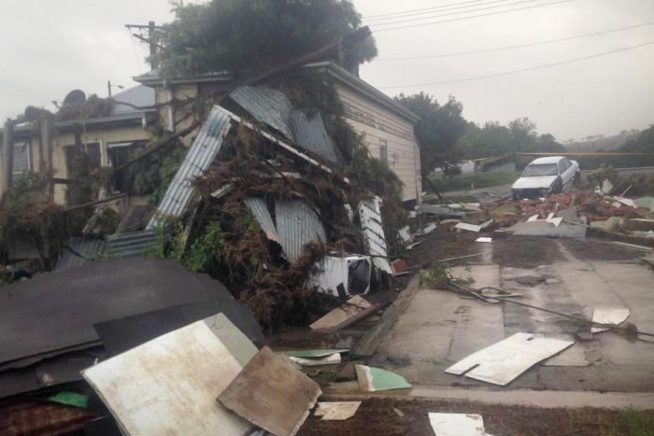
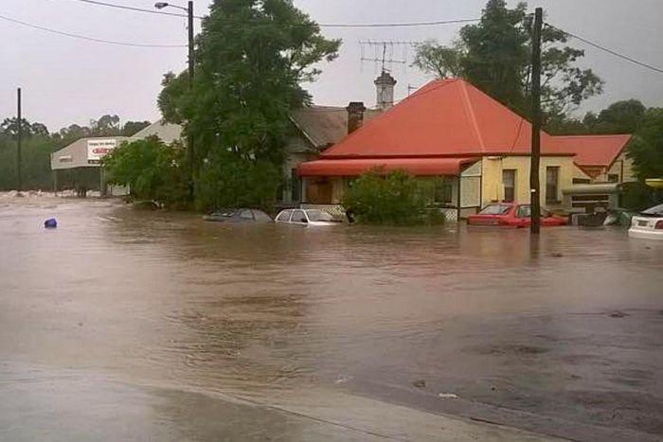
East Coast Low
20 – 23 April 2015
Intense low pressure systems that form close to NSW coast
Strong winds, heavy rain, flooding, major waves and coastal erosion
Major flood event for Dungog and Maitland, at least 4 deaths
Dozens of roofs lost, trees down, > 200000 houses without power, 57 schools closed
Worst ECL since the Pasha Bulker storm of 2007
Followed by another system a week later with 5 fatalities

Slide 3
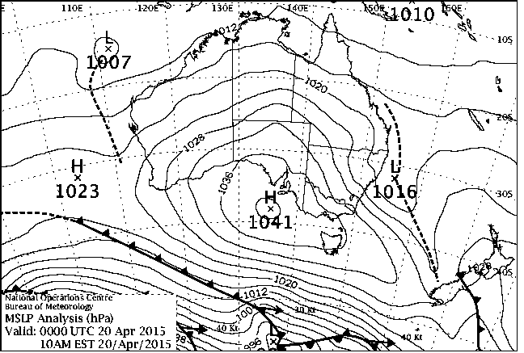
Synoptic MSLP

Slide 4
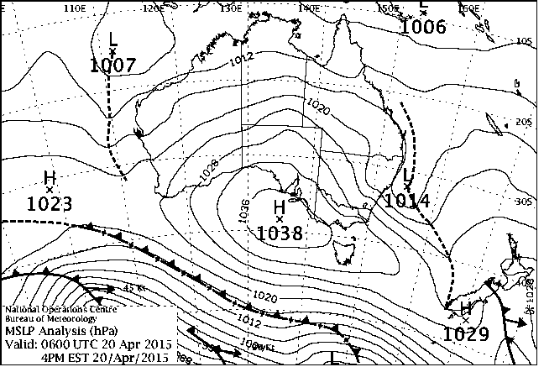
Synoptic MSLP

Slide 5
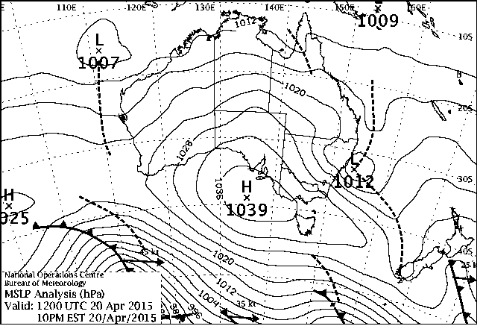
Synoptic MSLP

Slide 6
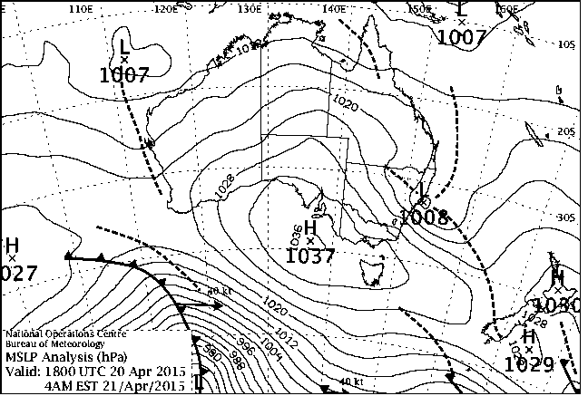
Synoptic MSLP

Slide 7
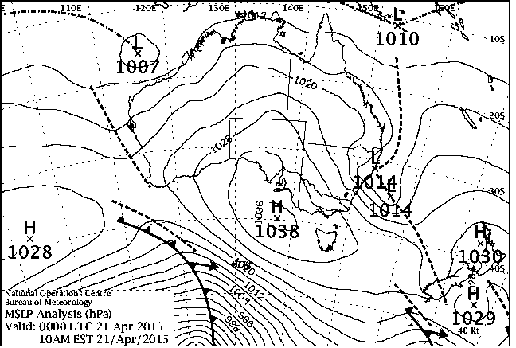
Synoptic MSLP

Slide 8
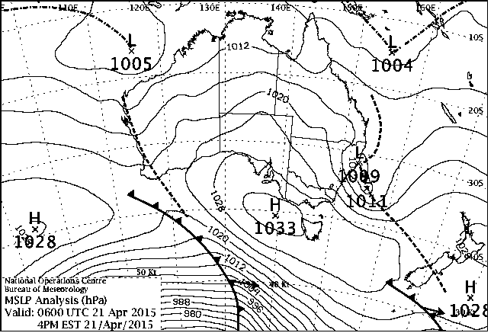
Synoptic MSLP

Slide 9
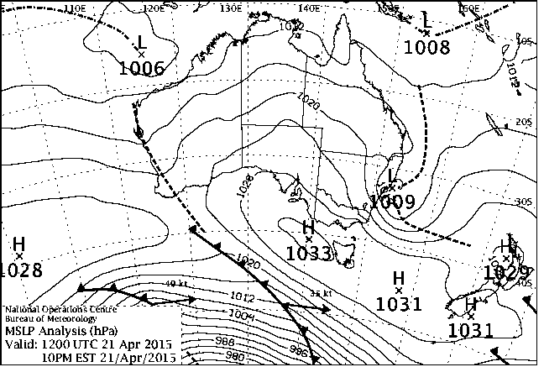
Synoptic MSLP

Slide 10
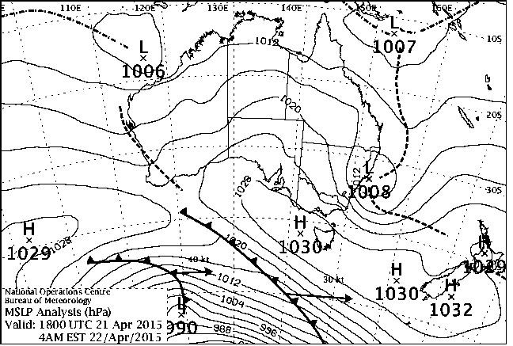
Synoptic MSLP

Slide 11
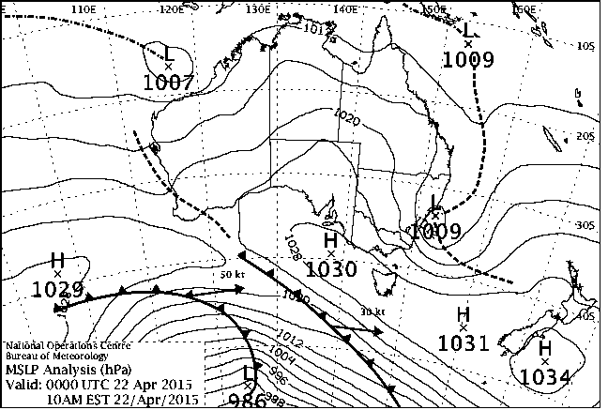
Synoptic MSLP

Slide 12
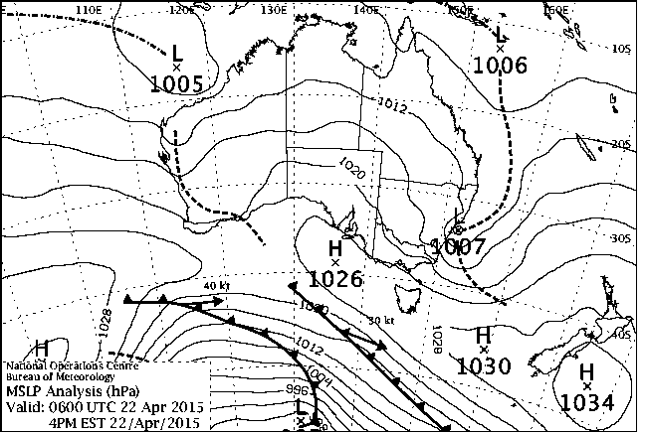
Synoptic MSLP

Slide 13
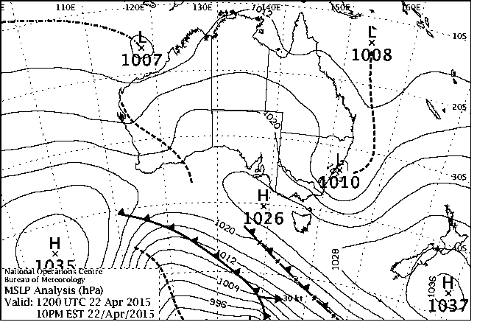
Synoptic MSLP

Slide 14
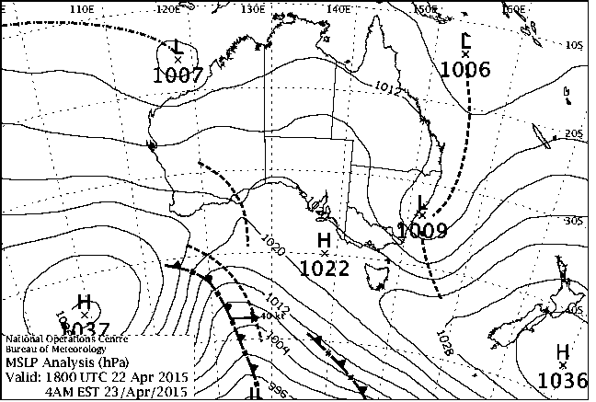
Synoptic MSLP

Slide 15
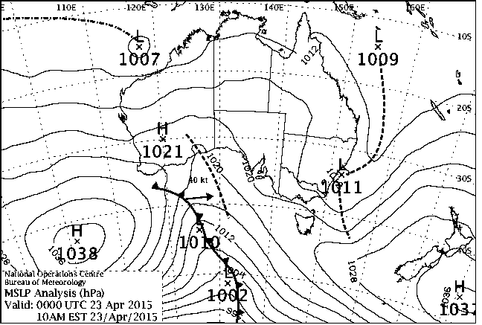

Slide 16
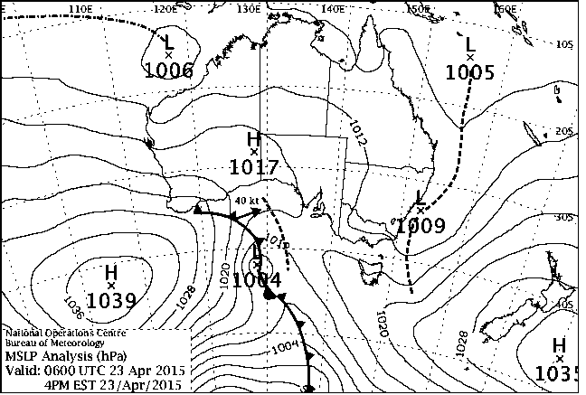

Slide 17
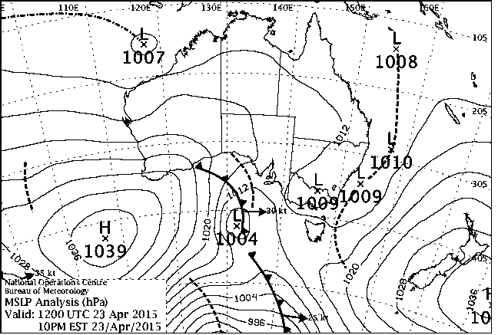

Slide 18
High-resolution ensemble prediction
Long-standing global and regional research ensemble systems
ACCESS-GE planned for APS-3
ACCESS-XE planned for APS-4
UKMO vision of hourly 1.5-km RUC ensemble,
~3 members/hr + time lag = ~20-member ensemble
Motivation:
Severe ECL, high impact + scientific interest, worthy of study
Good deterministic forecast, NWP study is feasible
Good case to start to look at what hi-res ensemble might deliver in severe weather (BoM operations + emergency services)
Good case to look at ensemble-based sensitivity analysis

Slide 19
Modelling setup
We took the 24-member ACCESS-GE trial initial conditions
valid 00 UTC April 20.
these are N216 = 432x324 = 0.83°x0.55° ≈ 90 km
1 control + 23 perturbation files (perturbations added to control offline)
Reran global model at N512 = 1024×768 ≈ 0.35°x0.23° ≈ 40 km
Downscaled to regional model: global → 4 km → 1.3 km
Global → 0.043°x0.036° → 0.014°x0.012°
70 levels
top at 80 km (global) → 40 km (nested)
Model integration time = 48 hours
Switch to LES-style 3-d Smagorinsky turbulence for 1.3 km.
Convective parameterisation: shallow only
✓ for 4 km
Not ideal for 1.3 km, but impact hopefully minor

Slide 20
Additional deterministic simulations
Three deterministic simulations were run, initialised
2015/04/19, 0300 UTC
2015/04/19, 1500 UTC
2015/04/20, 0300 UTC
These went down to 0.0048° × 0.004° resolution
Model integration time = 78 hours.

Slide 21
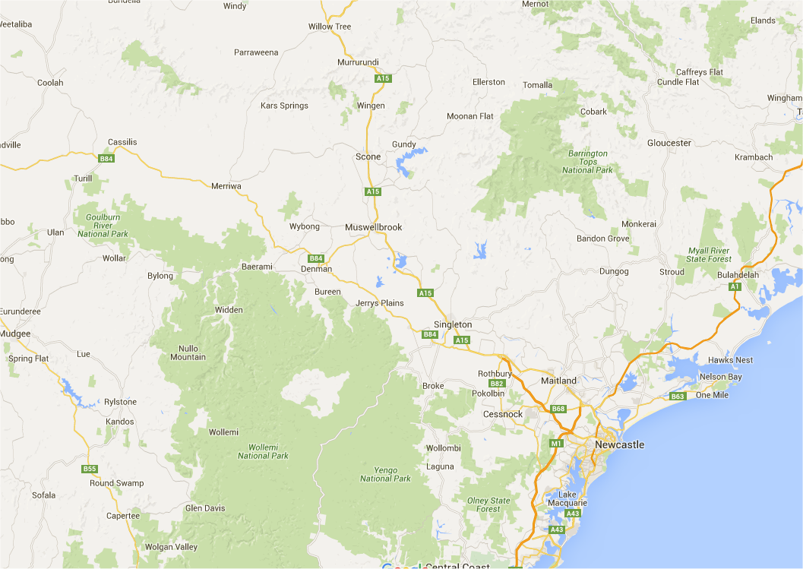
Locations – 8 AWSs in district 61
Murrurundi
Scone
Merriwa
Tocal
Cessnock
Williamtown
Lake Macquarie
Mangrove Mountain

Slide 22
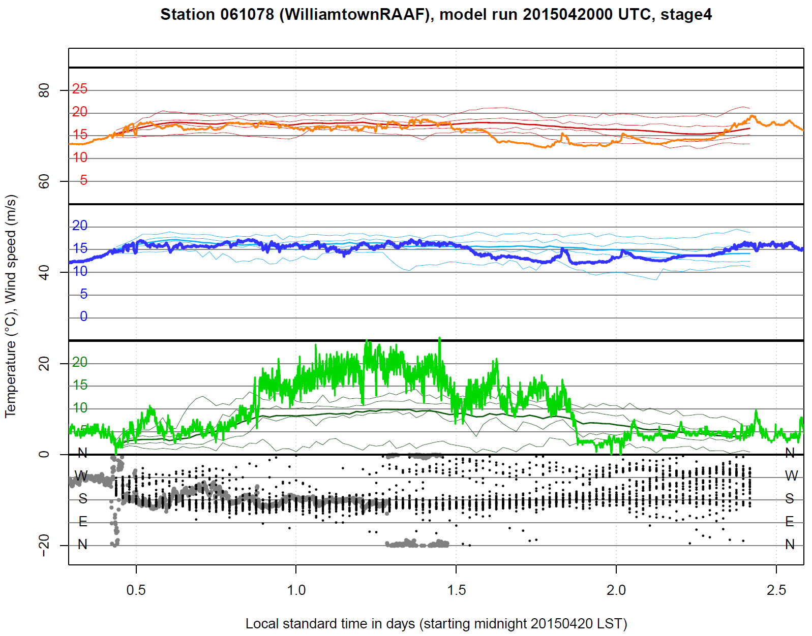
Model validation – district 61
Air temp.
Dewpoint temp.
10-metre wspd
10-metre wdirn
Ensemble
• max
• 75th perc.
• mean
• 25th perc.
• min
• values

Slide 23
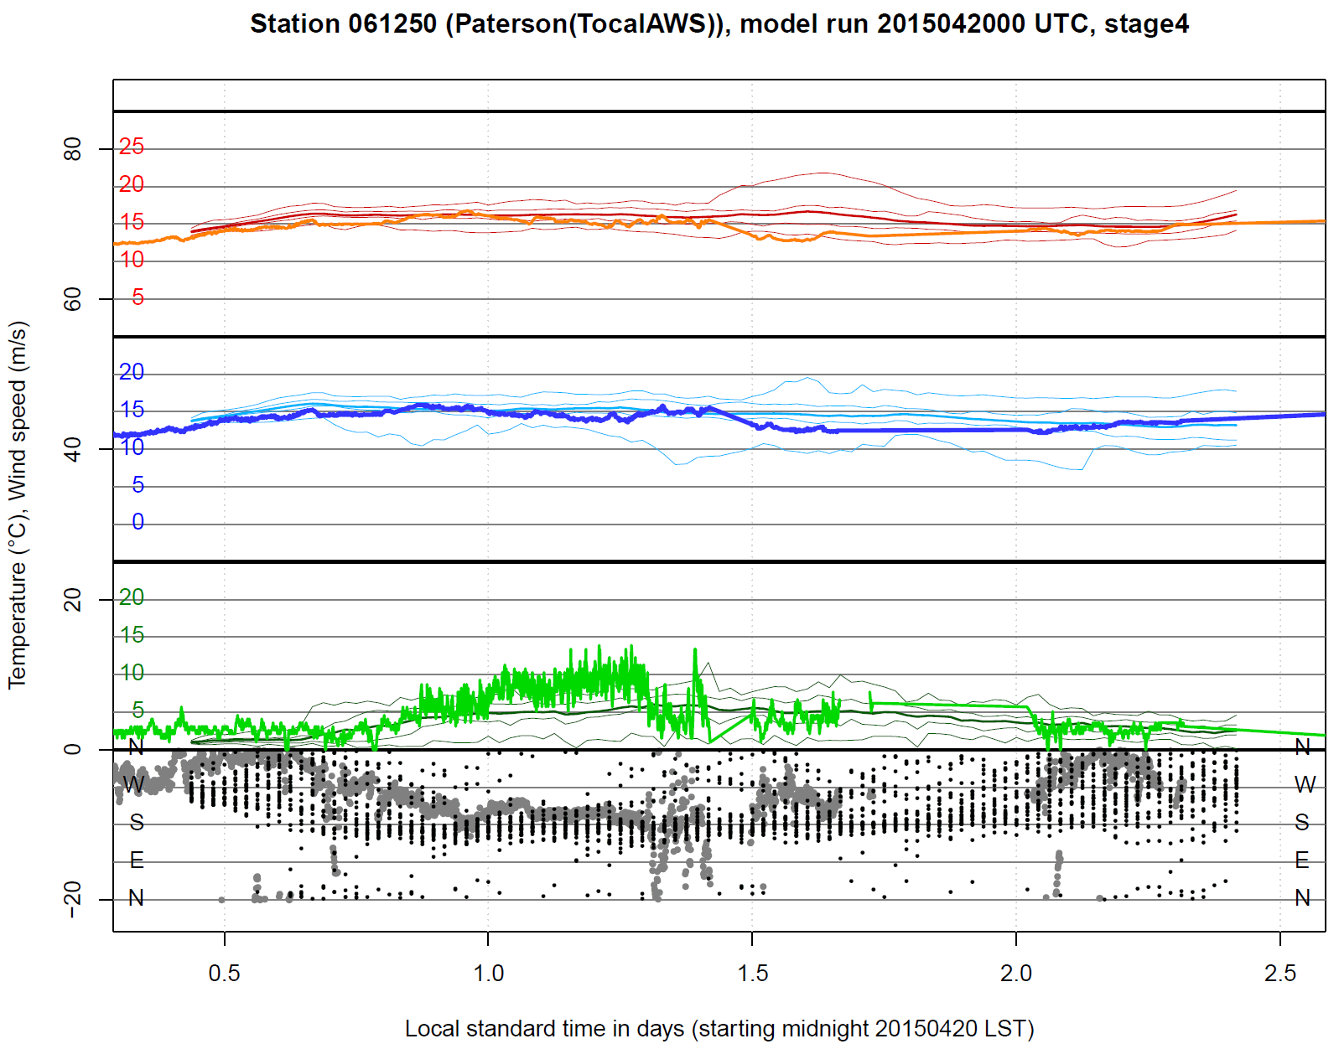
Model validation – district 61
Air temp.
Dewpoint temp.
10-metre wspd
10-metre wdirn
Ensemble
• max
• 75th perc.
• mean
• 25th perc.
• min
• values
data outage

Slide 24
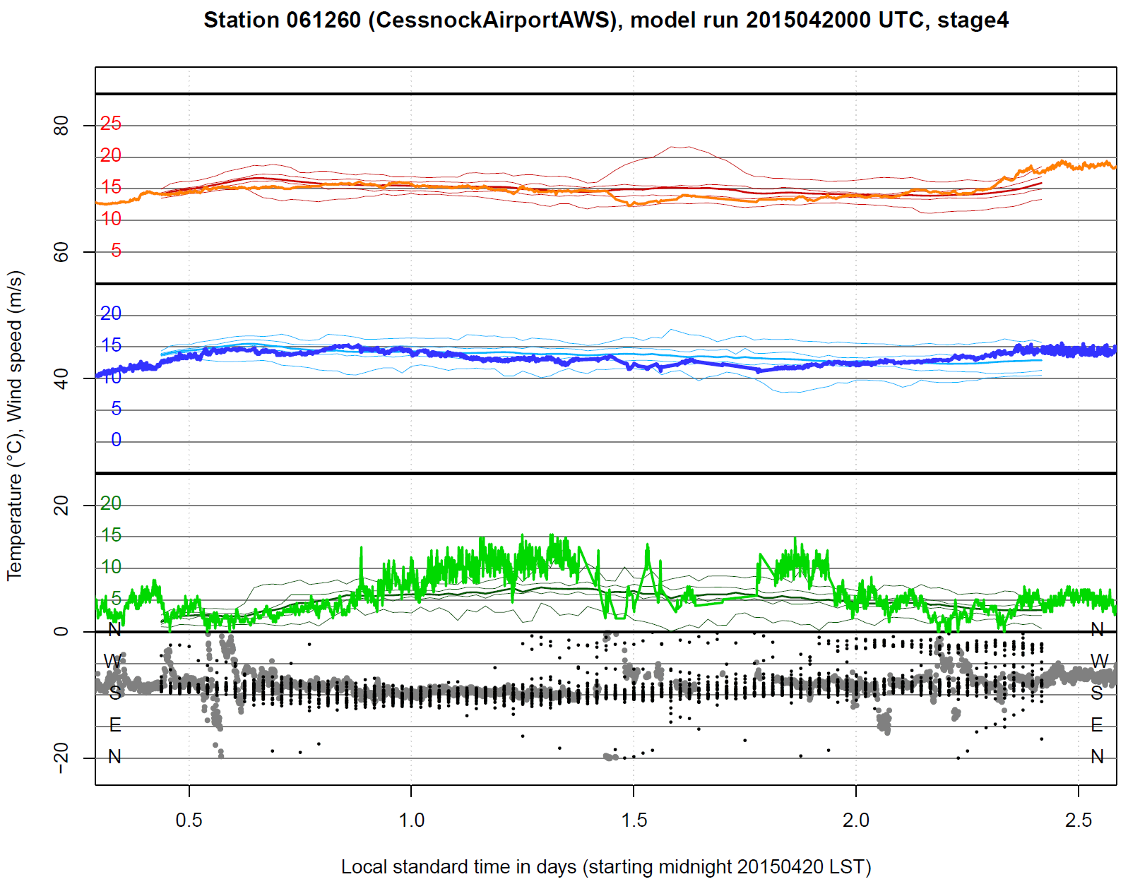
Model validation – district 61
Air temp.
Dewpoint temp.
10-metre wspd
10-metre wdirn
Ensemble
• max
• 75th perc.
• mean
• 25th perc.
• min
• values
data outage

Slide 25
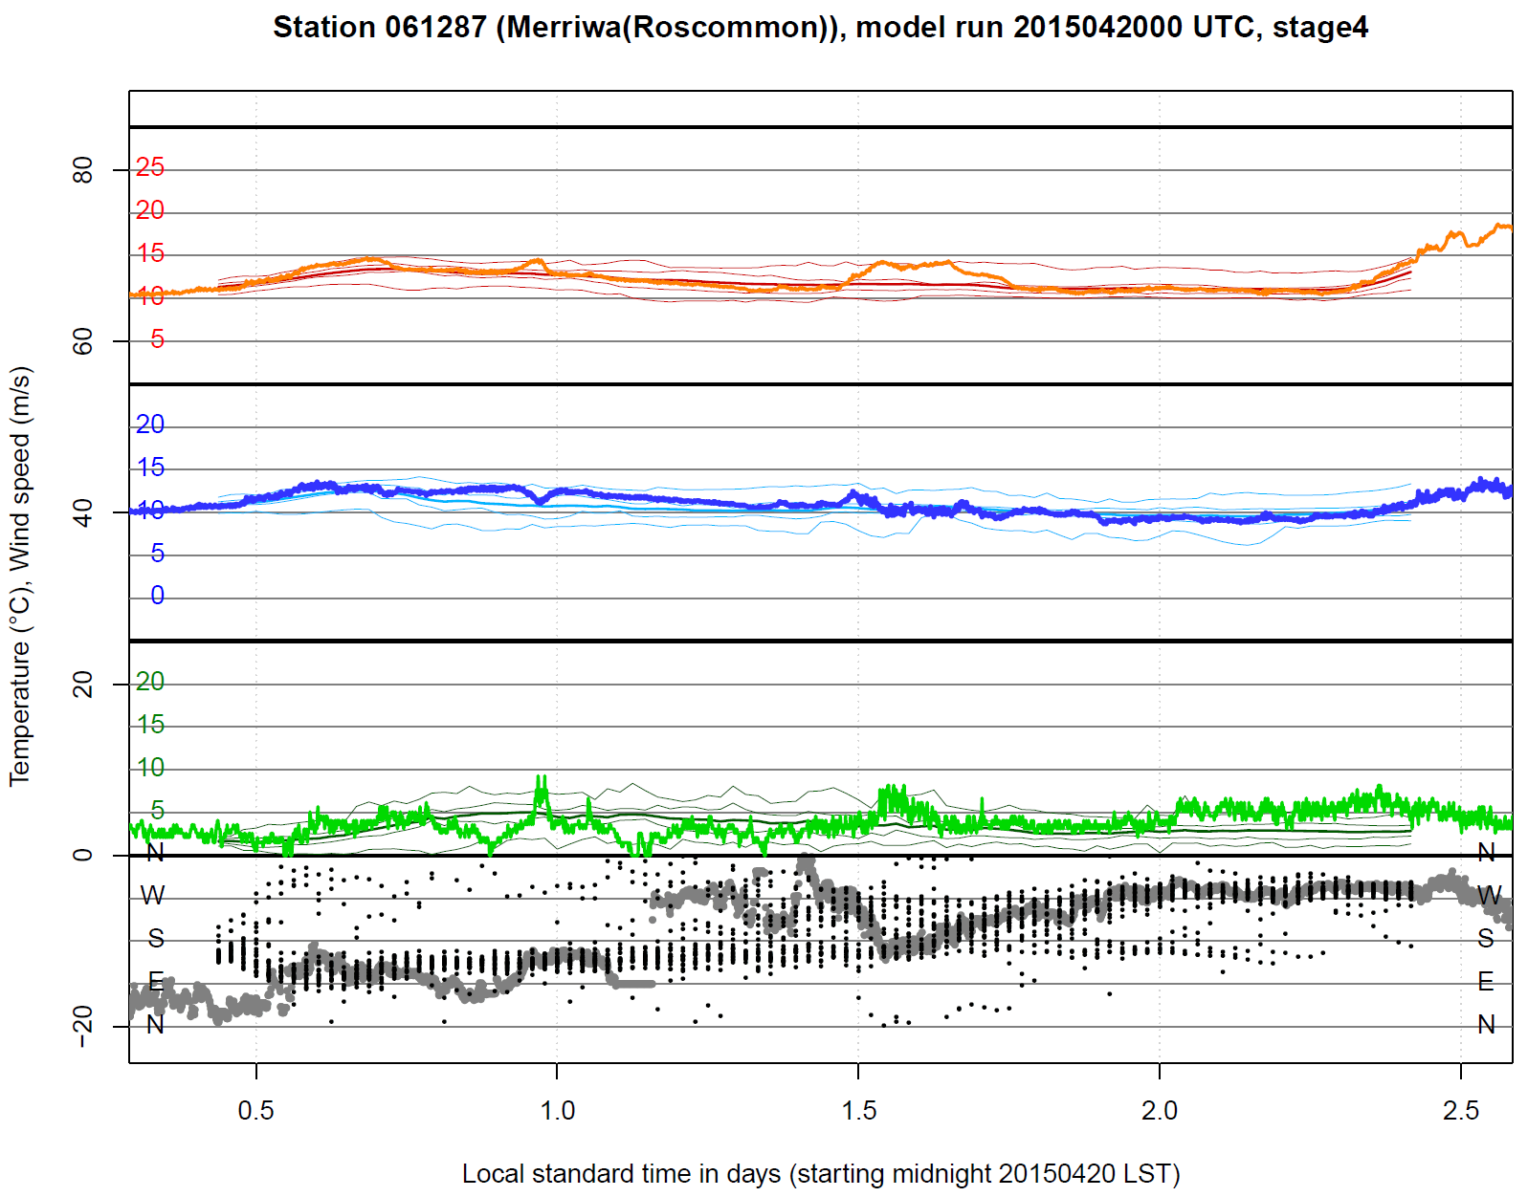
Model validation – district 61
Air temp.
Dewpoint temp.
10-metre wspd
10-metre wdirn
Ensemble
• max
• 75th perc.
• mean
• 25th perc.
• min
• values

Slide 26
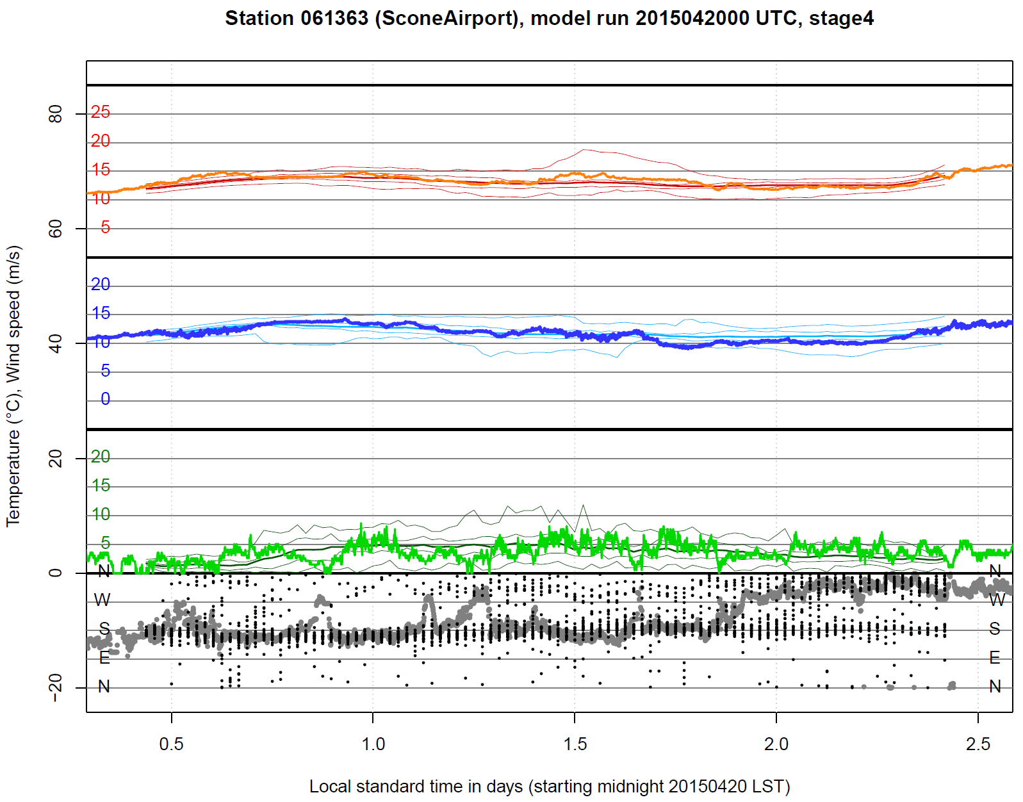
Model validation – district 61
Air temp.
Dewpoint temp.
10-metre wspd
10-metre wdirn
Ensemble
• max
• 75th perc.
• mean
• 25th perc.
• min
• values

Slide 27
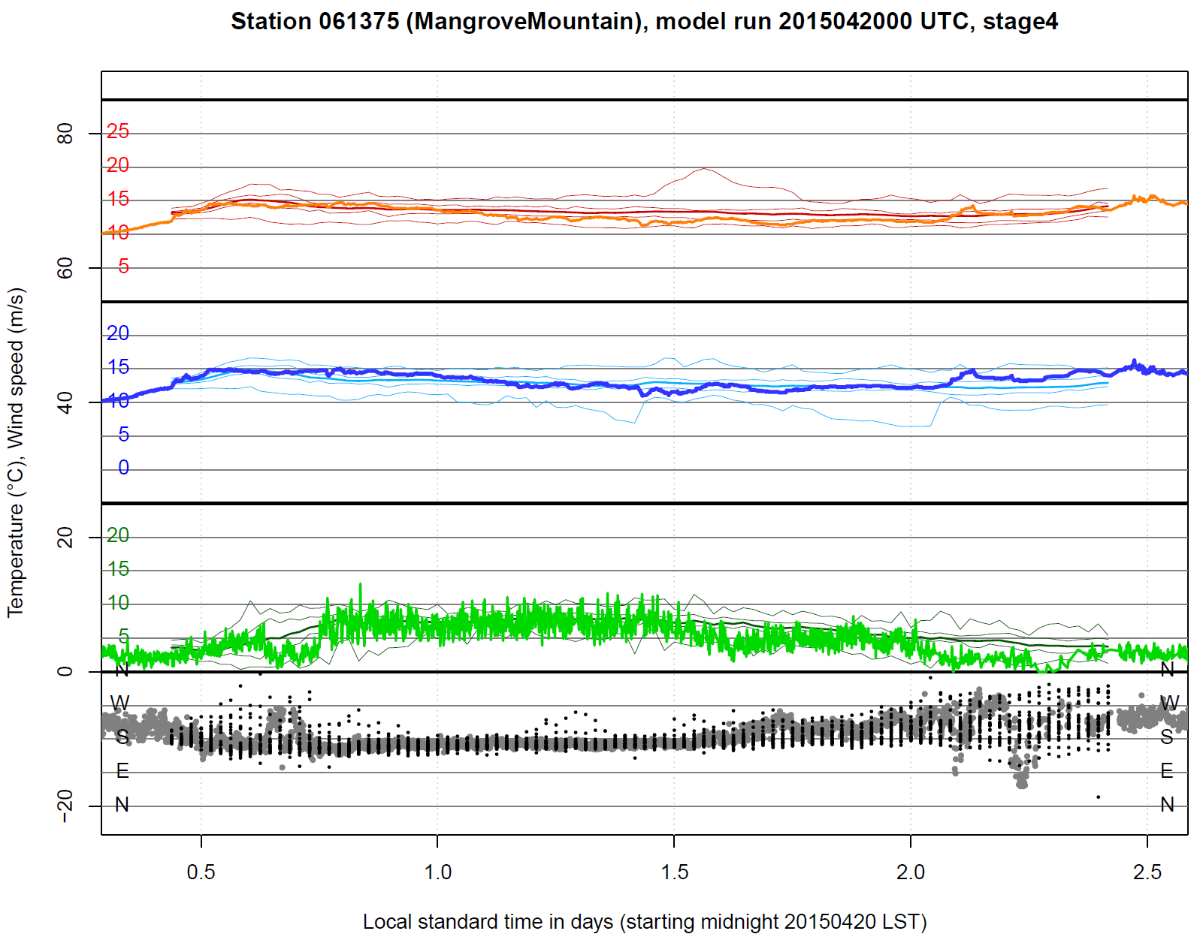
Model validation – district 61
Air temp.
Dewpoint temp.
10-metre wspd
10-metre wdirn
Ensemble
• max
• 75th perc.
• mean
• 25th perc.
• min
• values

Slide 28
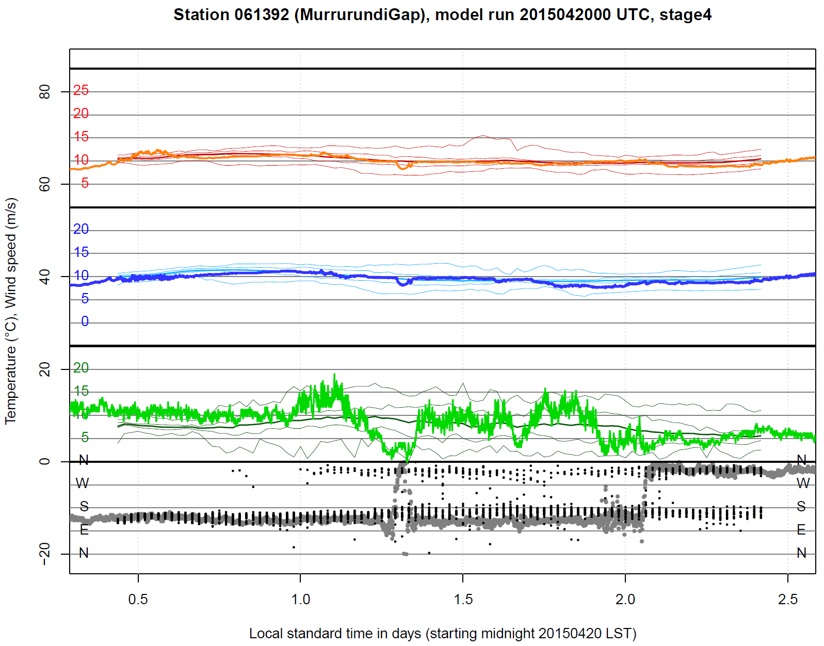
Model validation – district 61
Air temp.
Dewpoint temp.
10-metre wspd
10-metre wdirn
Ensemble
• max
• 75th perc.
• mean
• 25th perc.
• min
• values

Slide 29
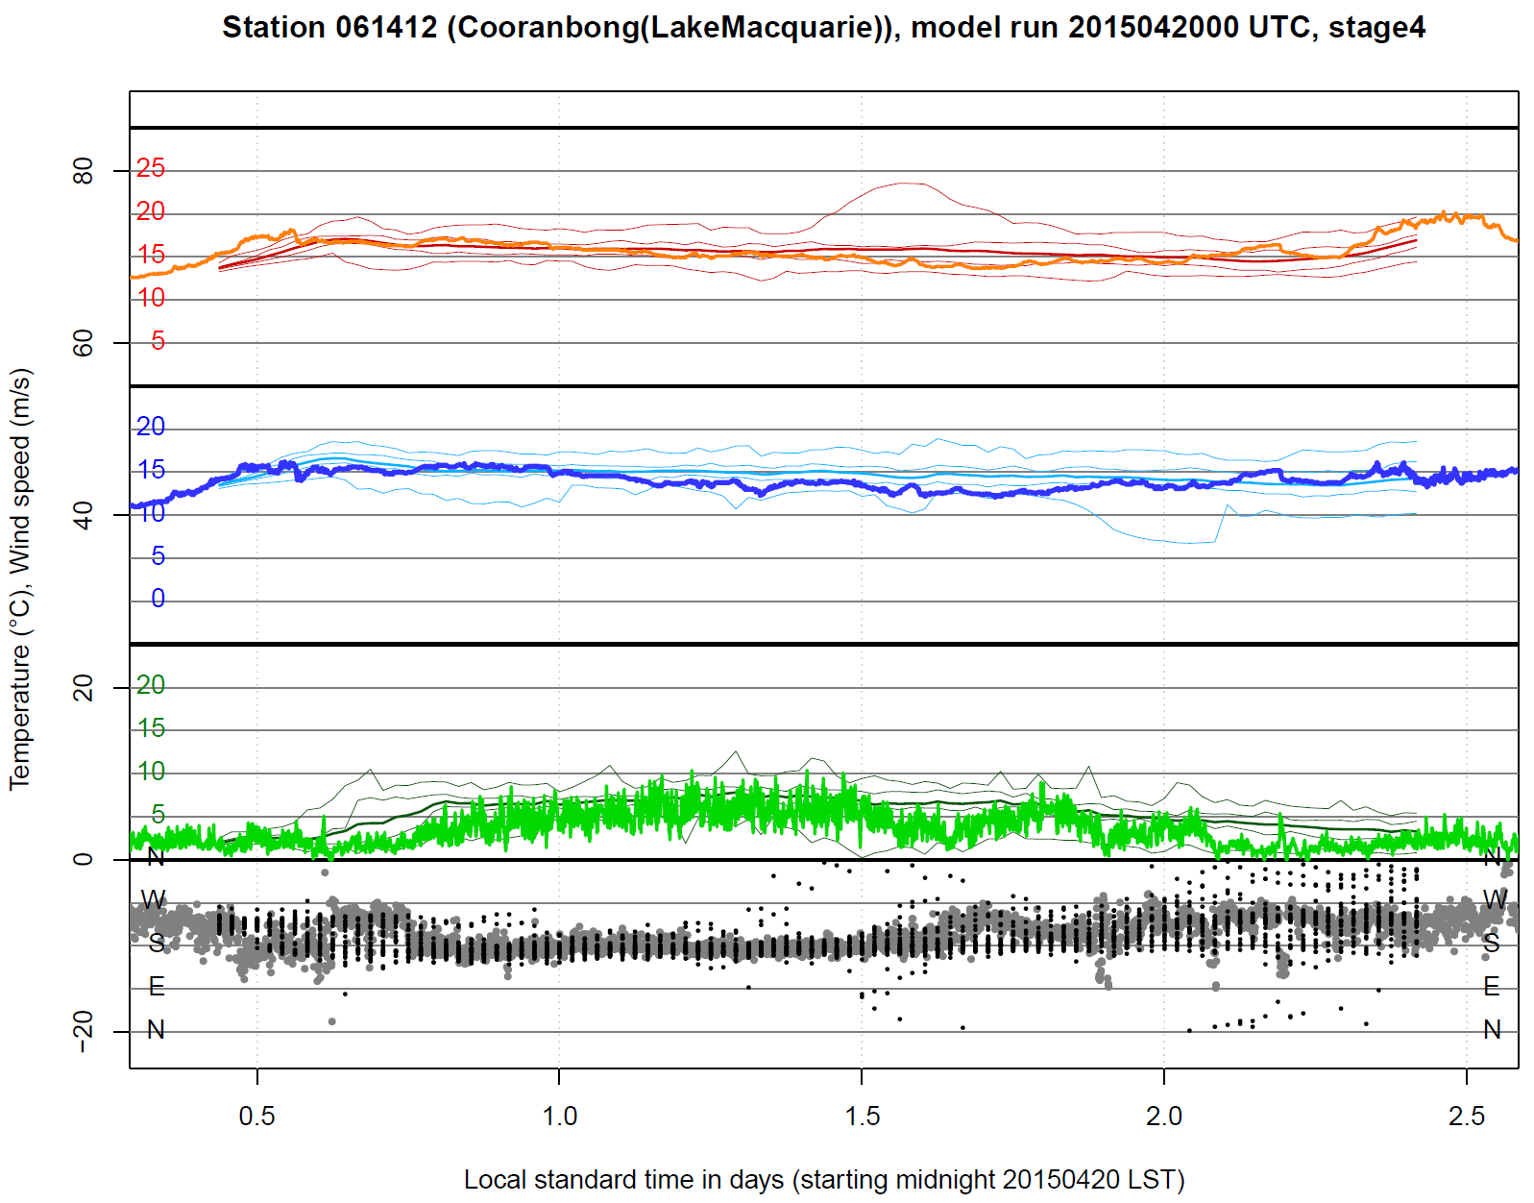
Model validation – district 61
Air temp.
Dewpoint temp.
10-metre wspd
10-metre wdirn
Ensemble
• max
• 75th perc.
• mean
• 25th perc.
• min
• values

Slide 30
Model validation - summary
Observed air temperature and dewpoint temperature mostly within ensemble range
Observed 10-m wind speed often within ensemble range, but at some sites forecast winds are much too weak
A familiar model failing
10-m wind direction tends to be well forecast under strong wind conditions, but quite poorly under weak wind conditions

Slide 31
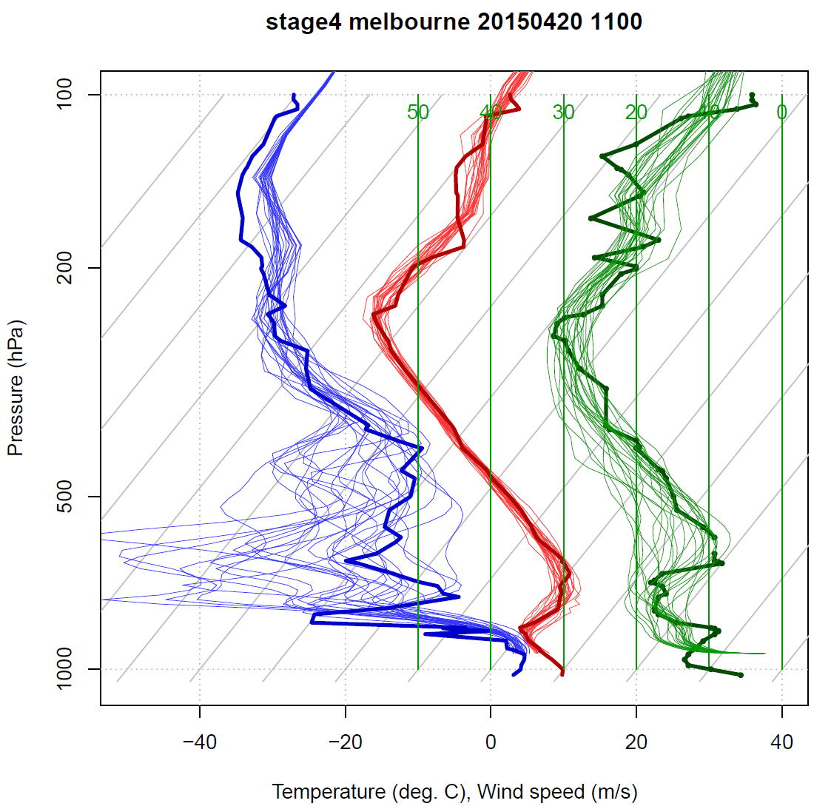
Model validation - soundings
Dewpoint temperature
Air temperature
Windspeed

Slide 32
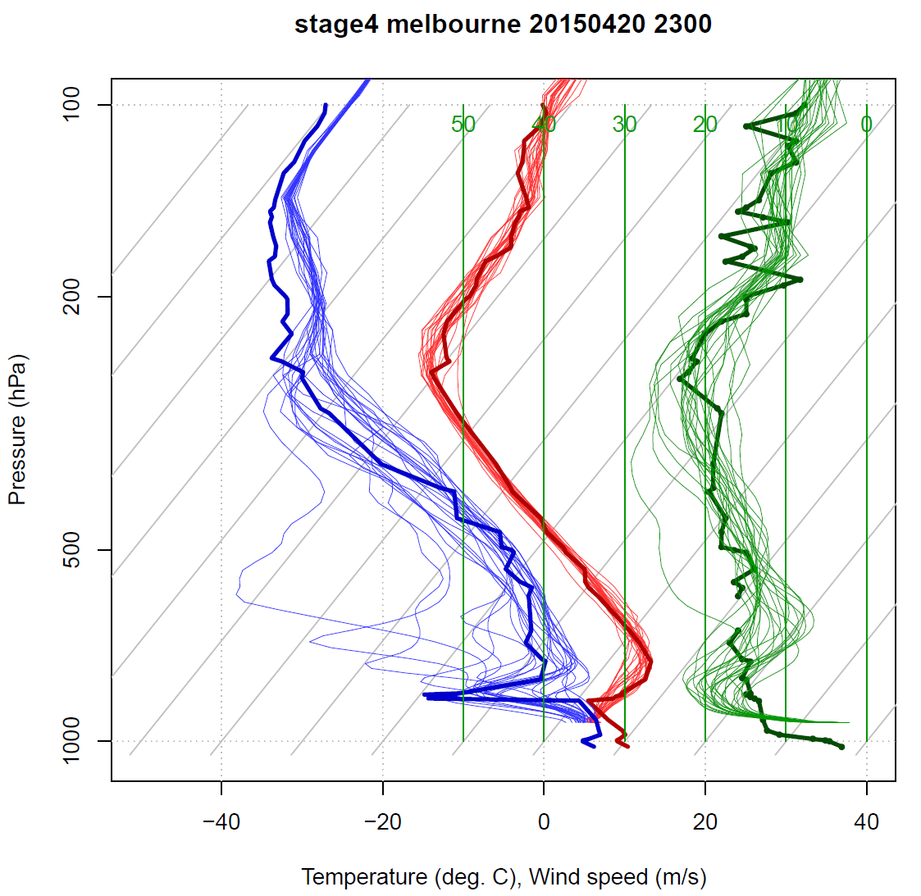
Model validation - soundings
Dewpoint temperature
Air temperature
Windspeed

Slide 33
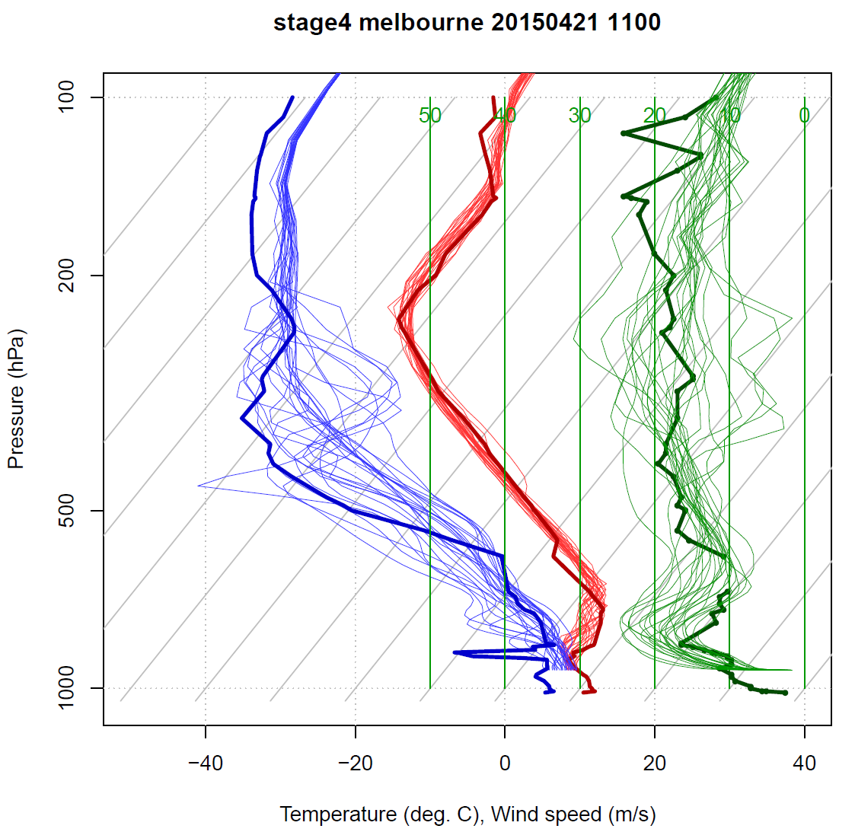
Model validation - soundings
Dewpoint temperature
Air temperature
Windspeed

Slide 34
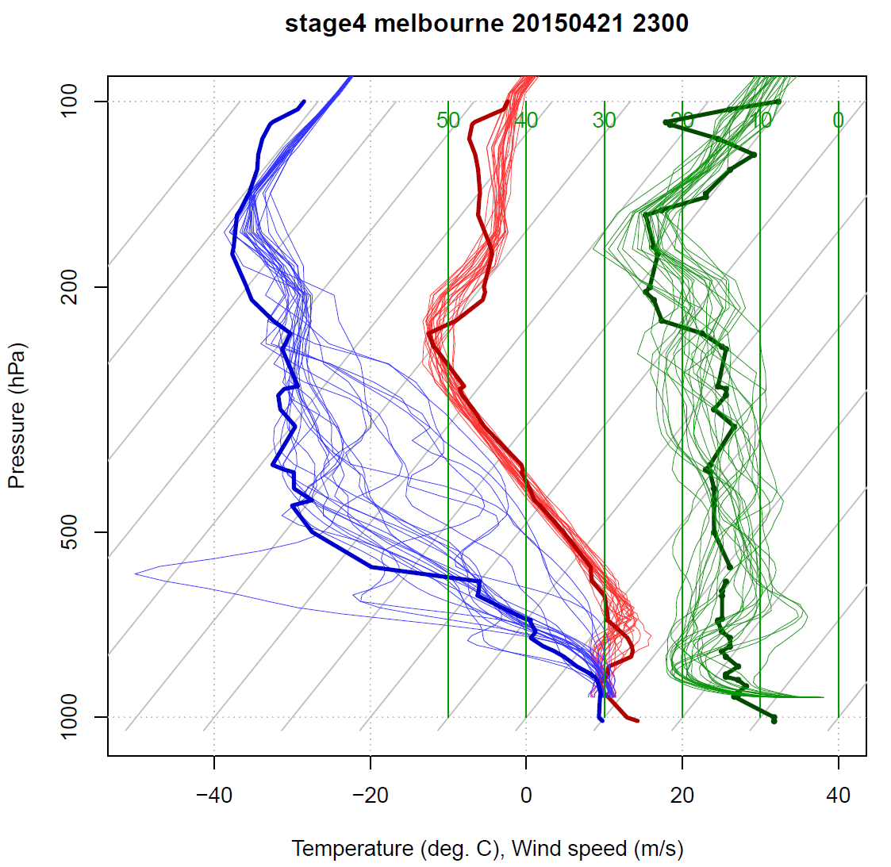
Model validation - soundings
Dewpoint temperature
Air temperature
Windspeed

Slide 35
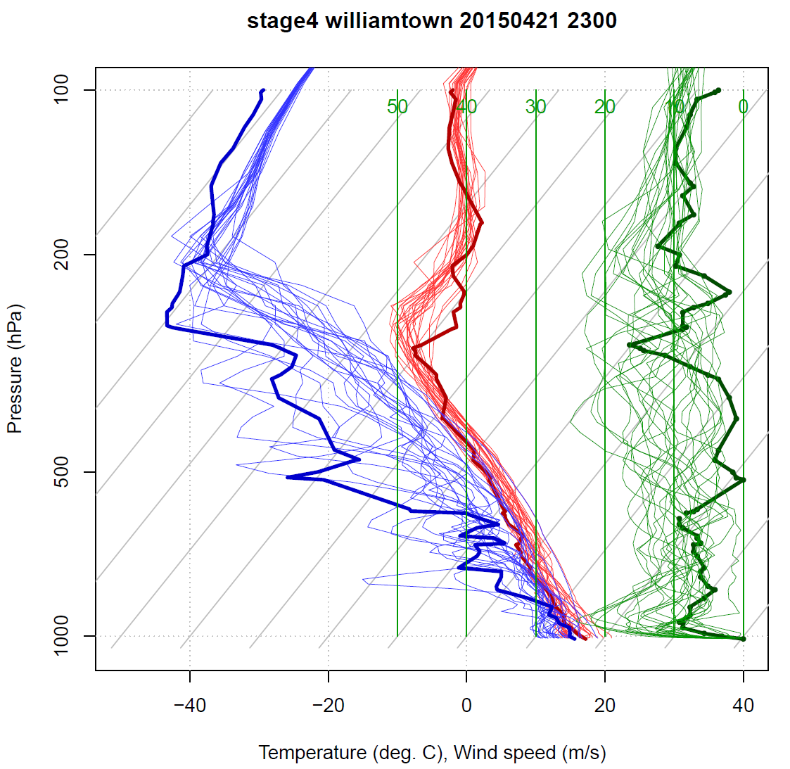
Model validation - soundings
Dewpoint temperature
Air temperature
Windspeed

Slide 36
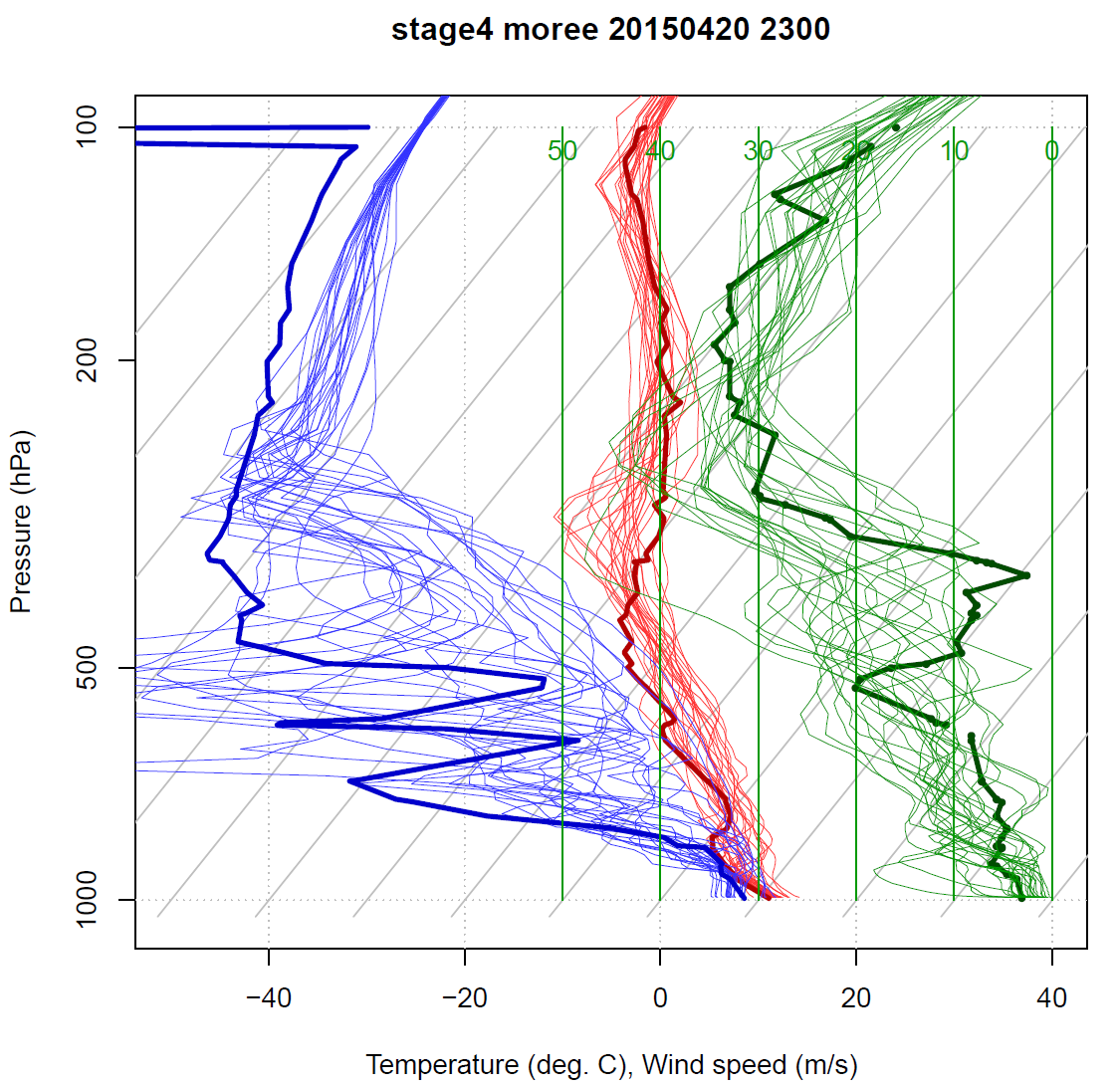
Model validation - soundings
Dewpoint temperature
Air temperature
Windspeed

Slide 37
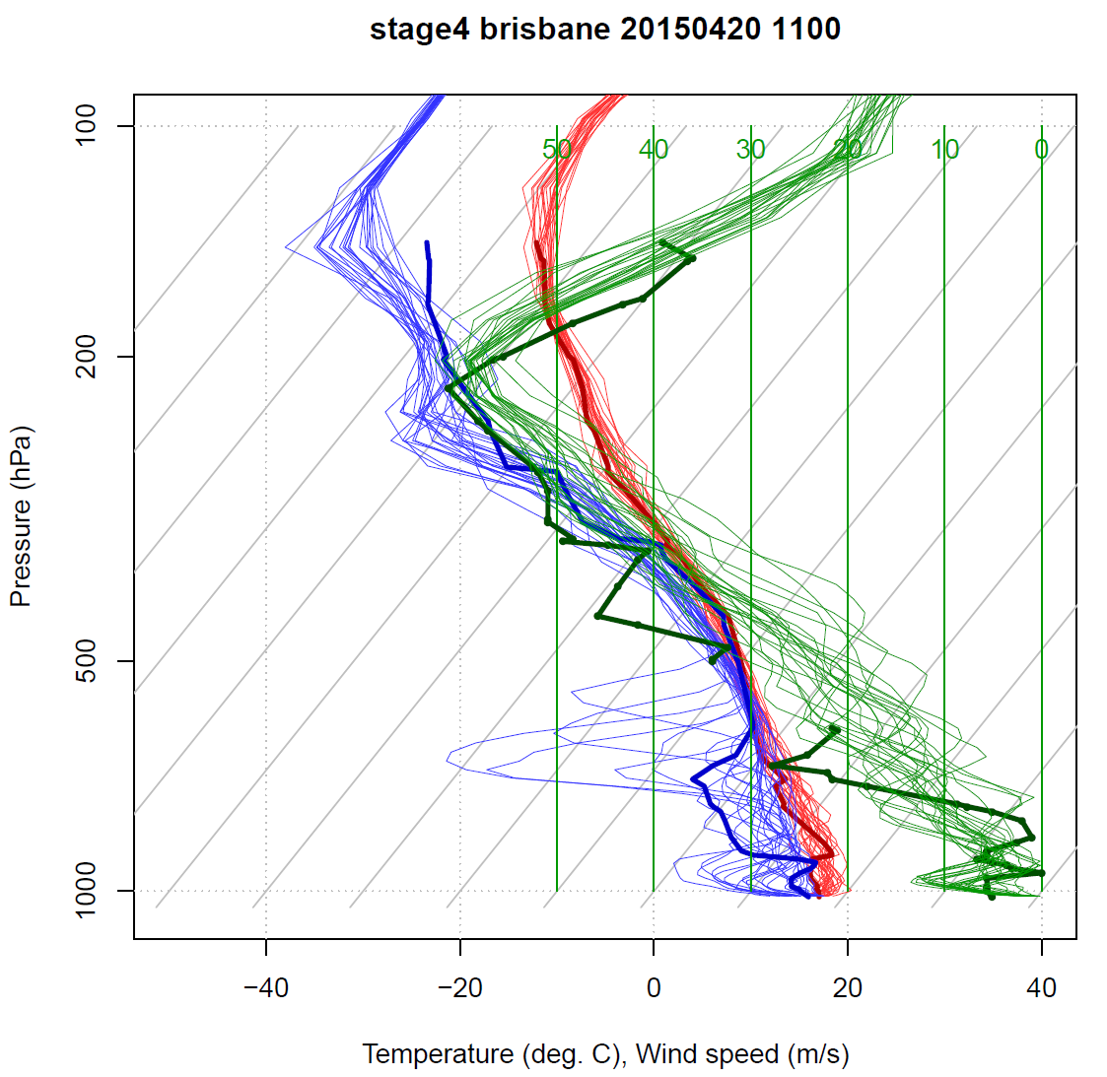
Model validation - soundings
Dewpoint temperature
Air temperature
Windspeed

Slide 38
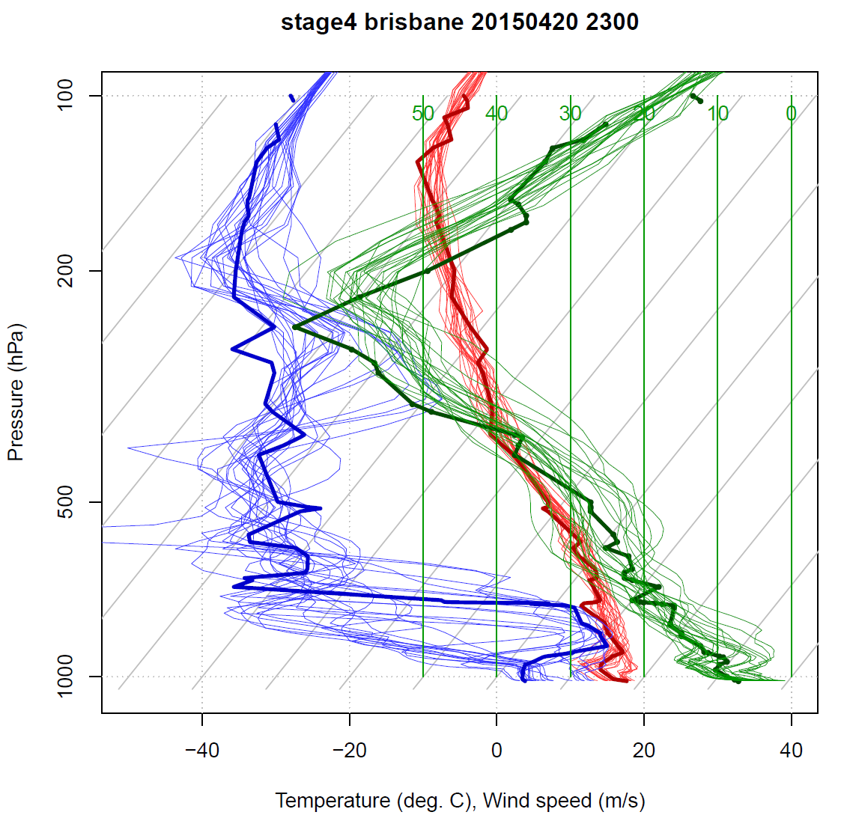
Model validation - soundings
Dewpoint temperature
Air temperature
Windspeed

Slide 39
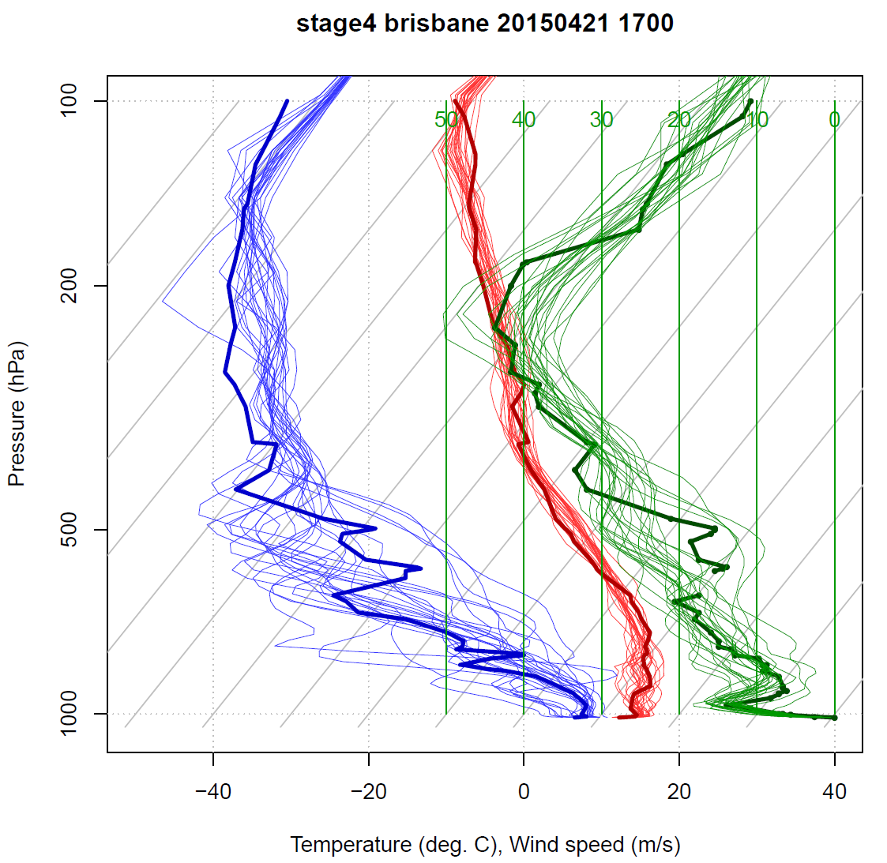
Model validation - soundings
Dewpoint temperature
Air temperature
Windspeed

Slide 40
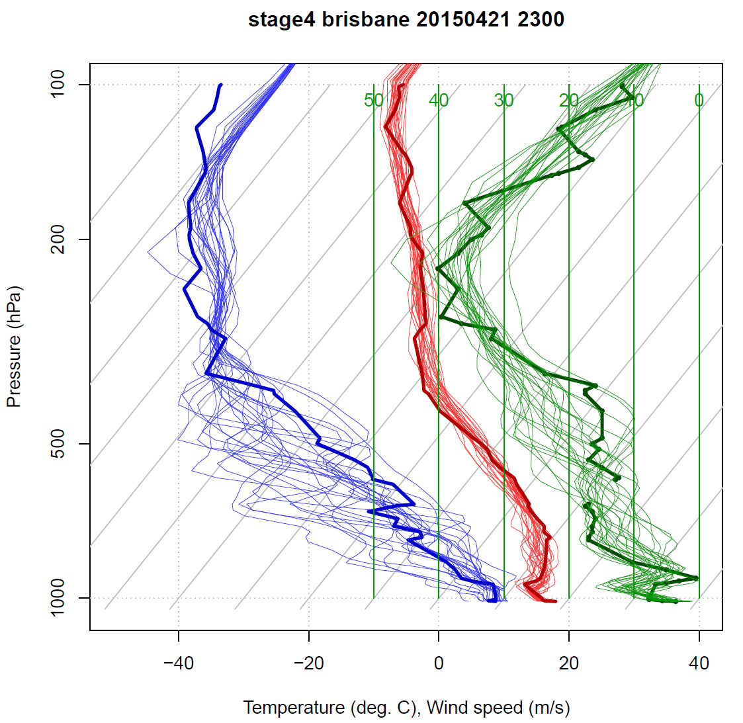
Model validation - soundings
Dewpoint temperature
Air temperature
Windspeed

Slide 41
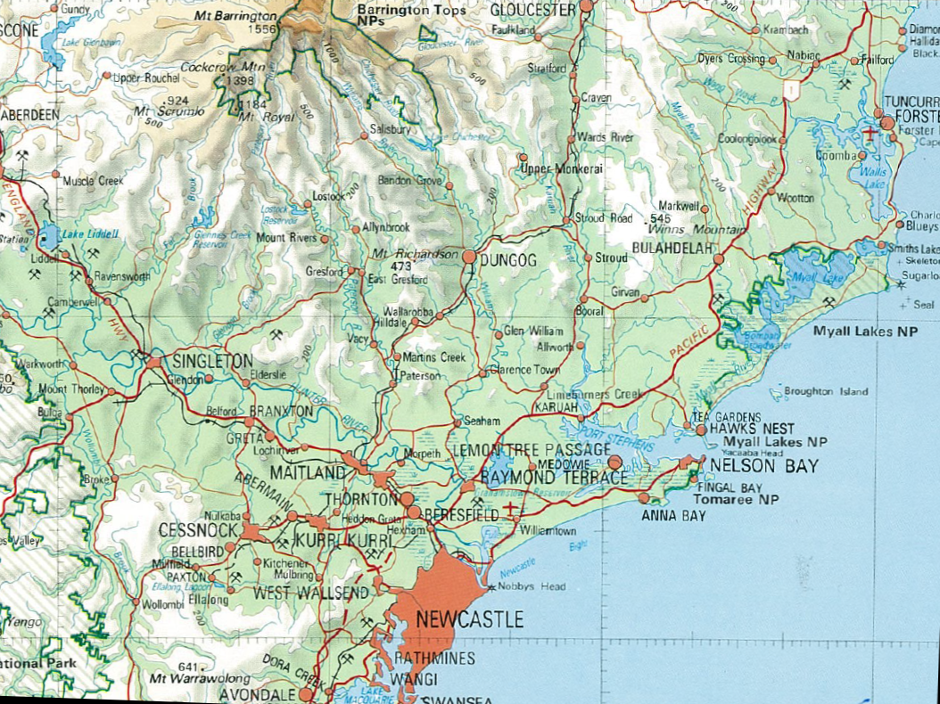
Region affected

Slide 42
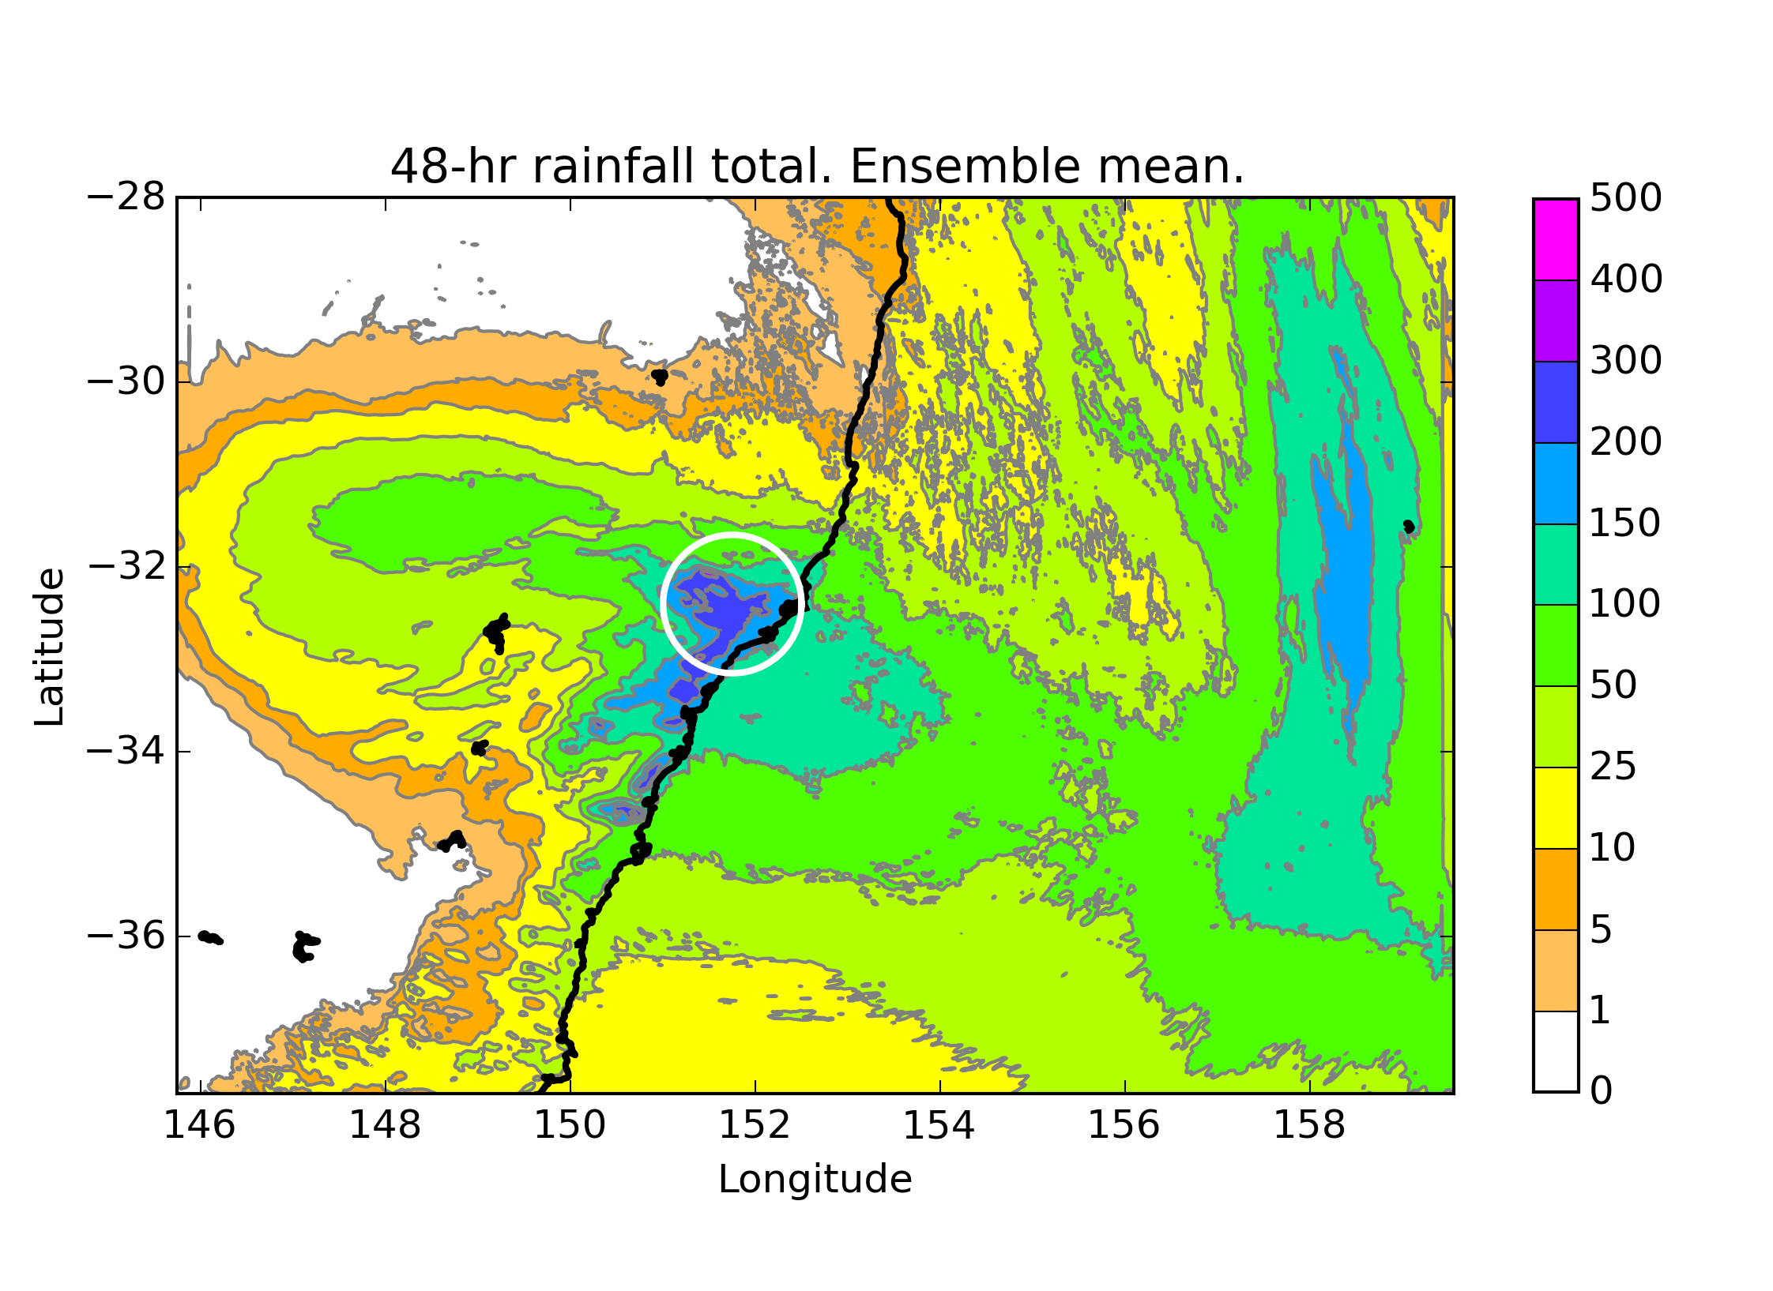
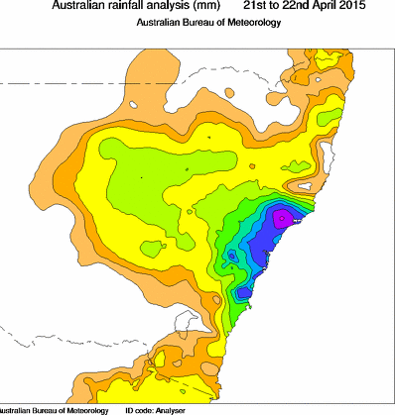
48-hr Rainfall Verification

Slide 43
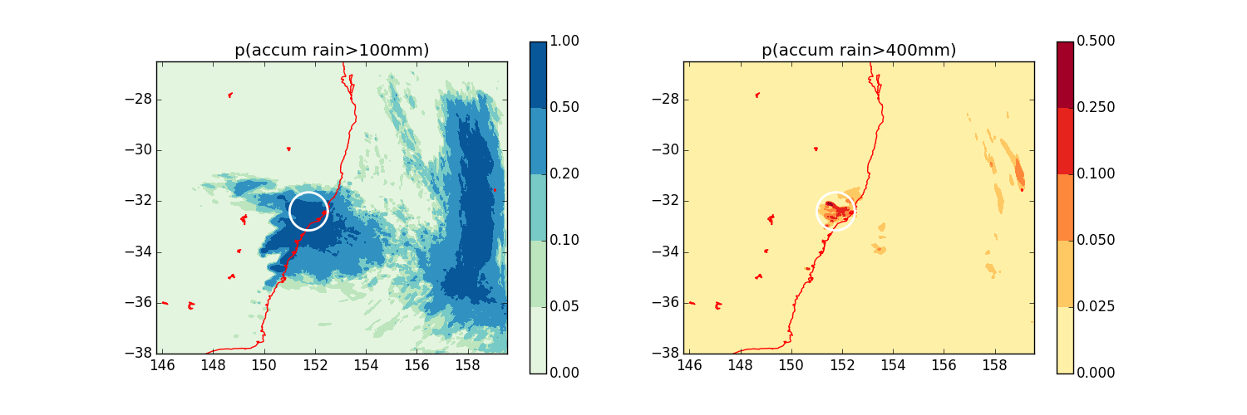
Rainfall probabilities
Probabilities of 48-hour total rainfall exceeding 100 mm and 400 mm
Based on ensemble member count • convolved over a radius of 5 gridpoints = 7 km.

Slide 44
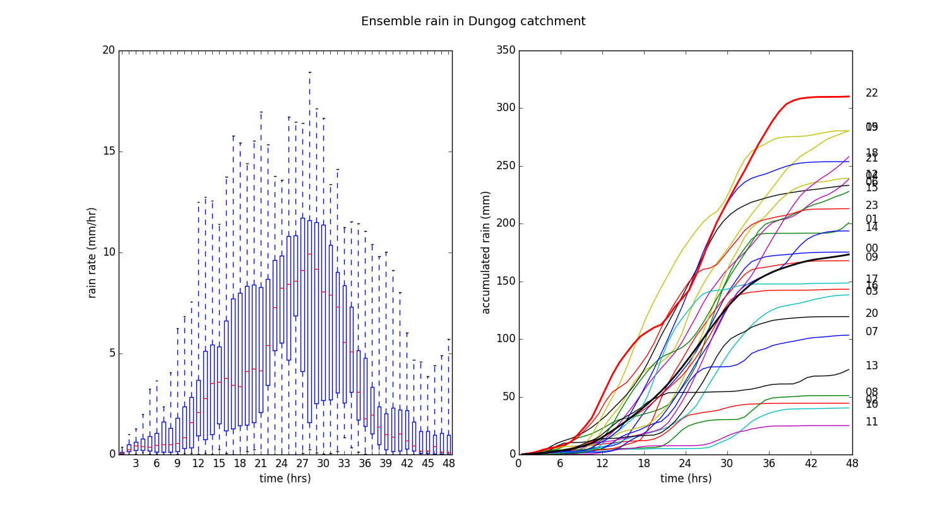
Rainfall distribution Dungog catchment
Left: hourly rainfall distribution
Right: rainfall accumulation by ensemble member
Averaged over 50-km circle centred on Dungog catchment

Slide 45
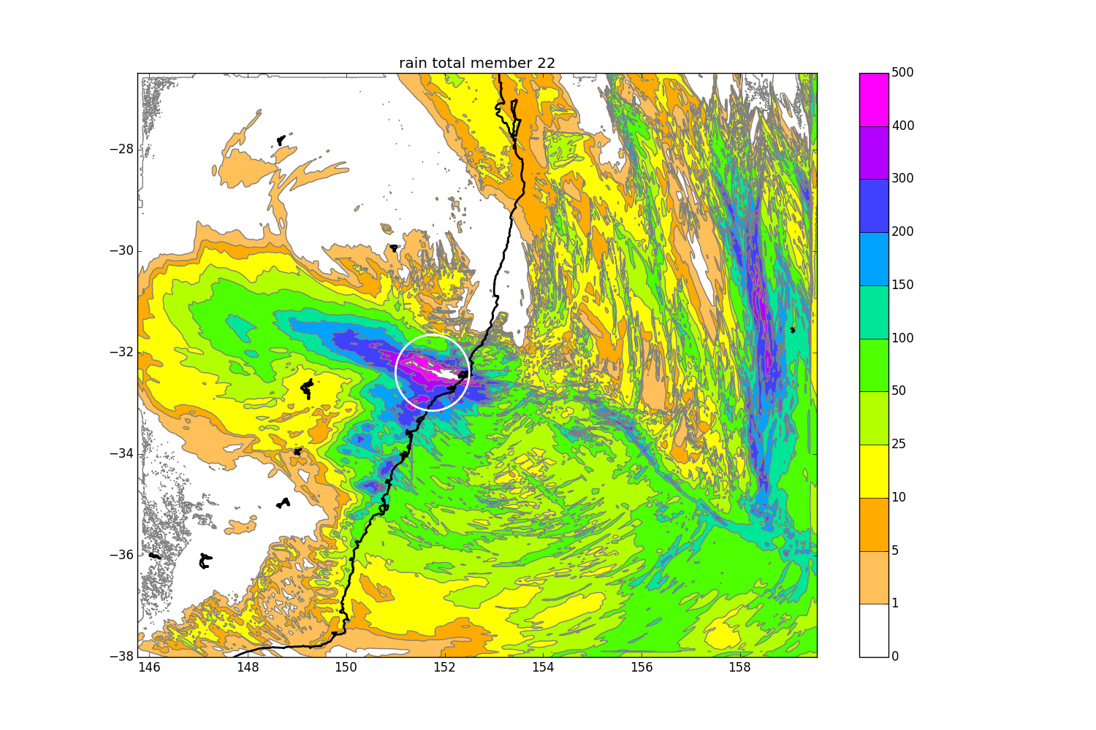
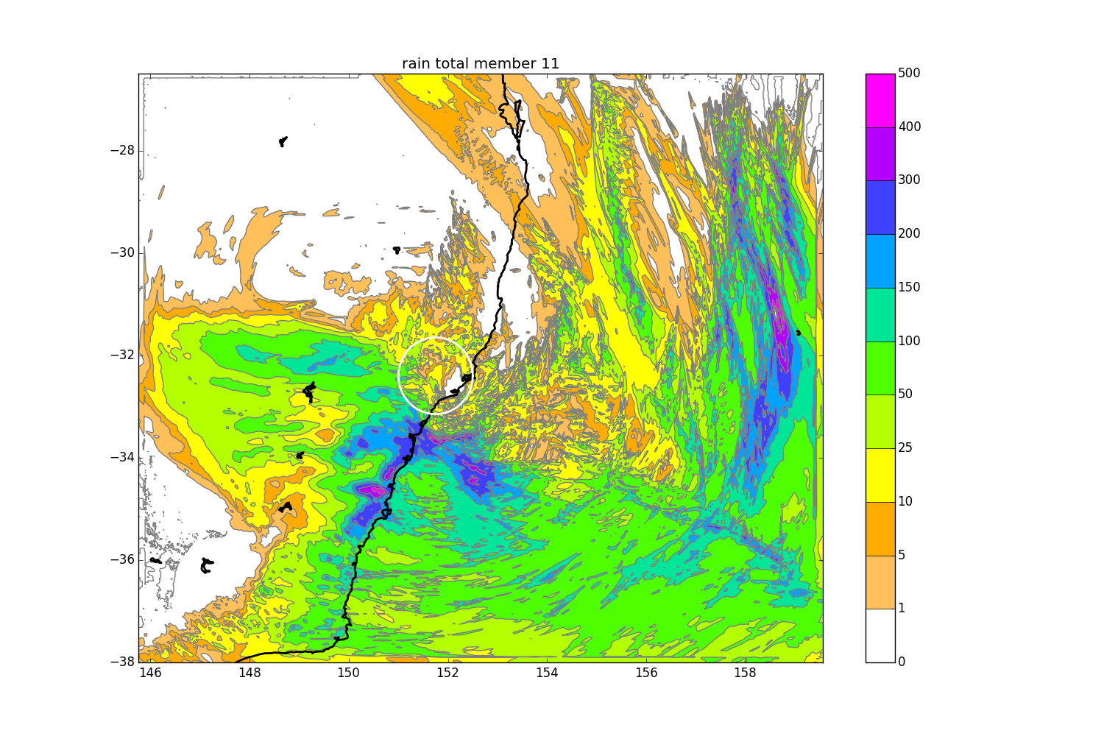
Wettest member vs driest member
"… a number of challenging forecast issues emerged. These included estimating the location along the coast, and the intensity, of the region of maximum winds and rainfall and how these related to the position of the developing low …"
Mills et al. (2010)
CAWCR Tech Report on Pasha Bulker storm

Slide 46
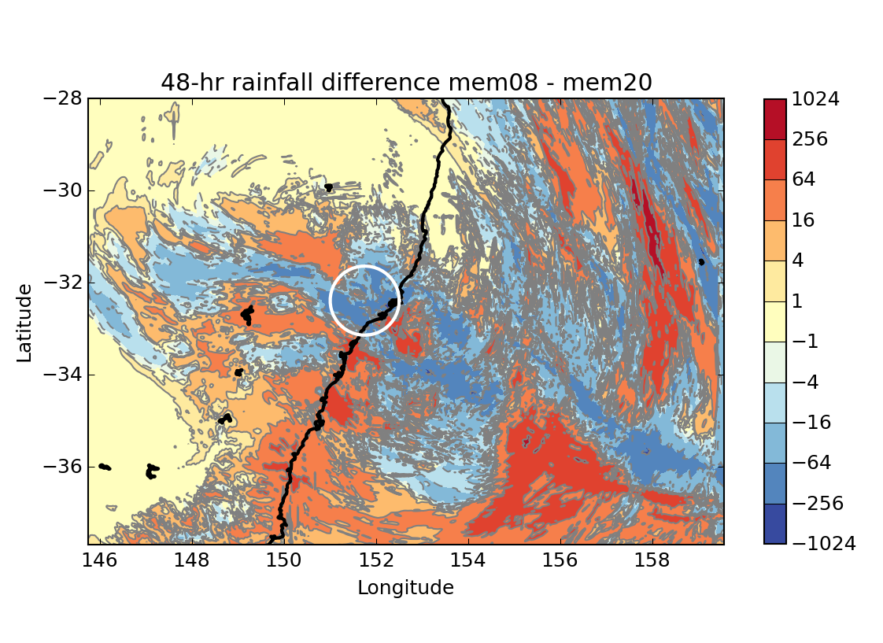
Rainfall differences: SST or ???
Difference in 48-hour rainfall between two randomly-chosen members

Slide 47
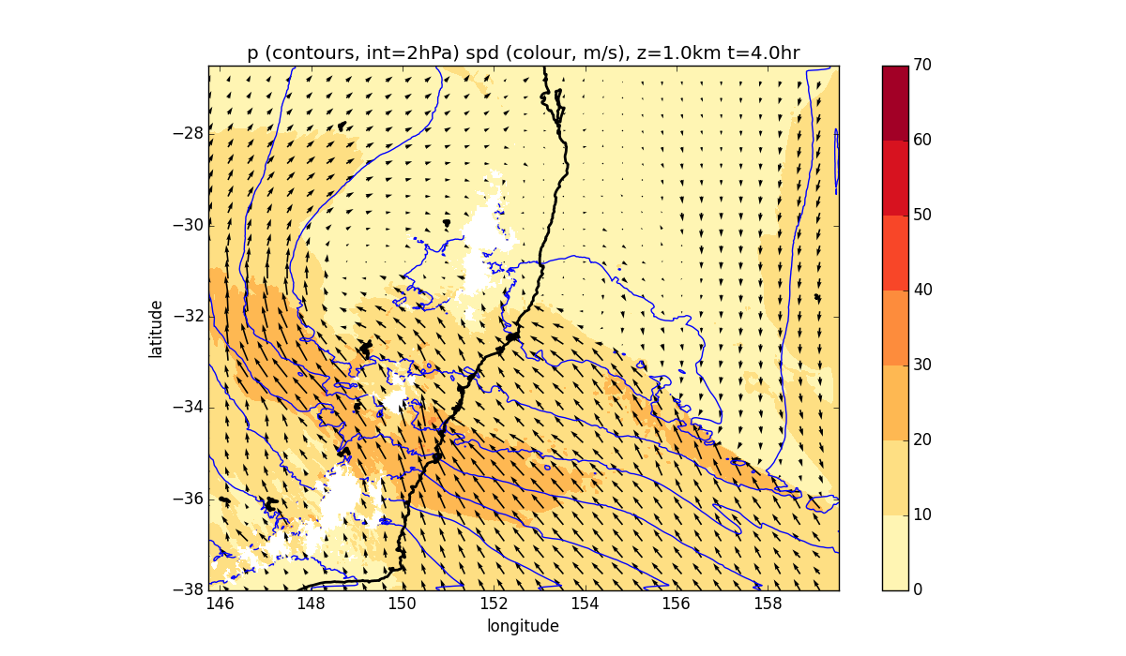
Wind and p at z = 1 km, 04UTC April 21
Wettest member (22)

Slide 48
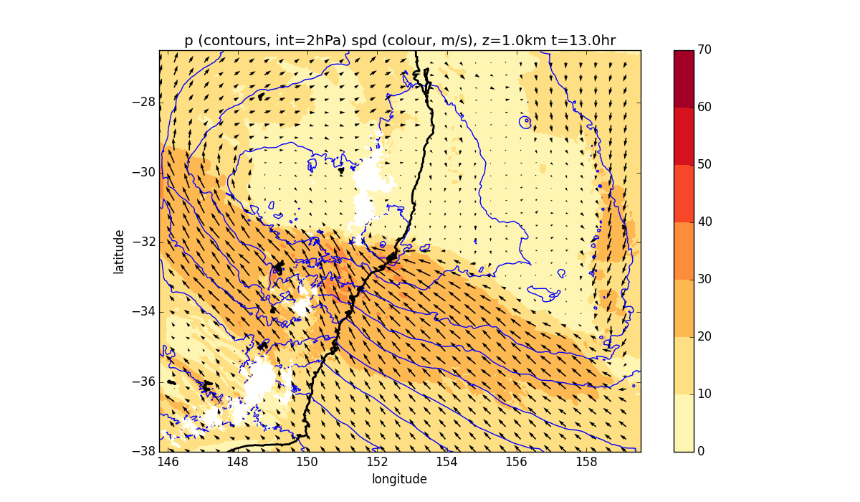
Wind and p at z = 1 km, 13UTC April 21
Wettest member (22)

Slide 49
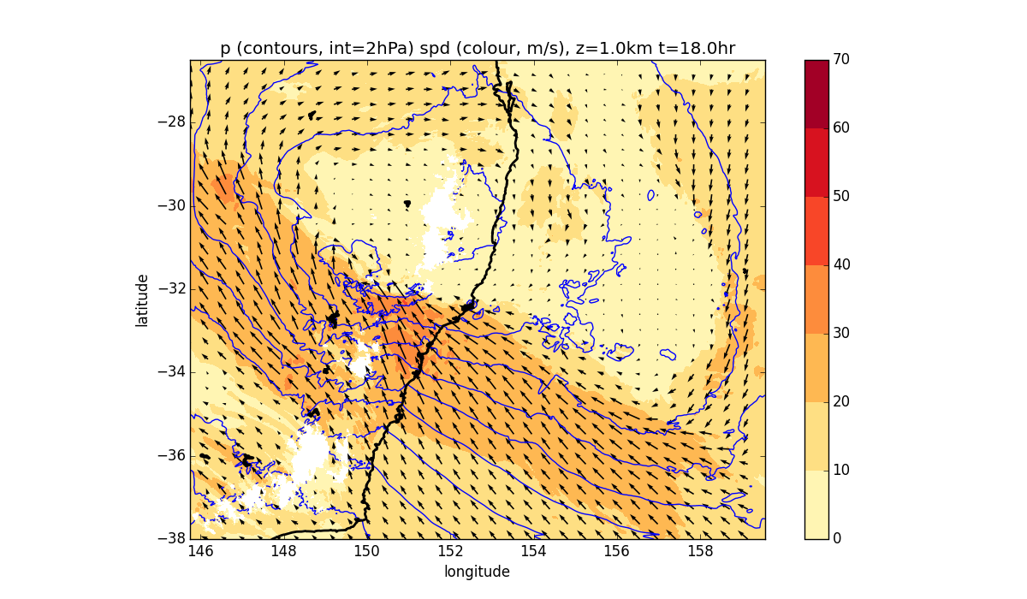
Wind and p at z = 1 km, 18UTC April 21
Wettest member (22)

Slide 50
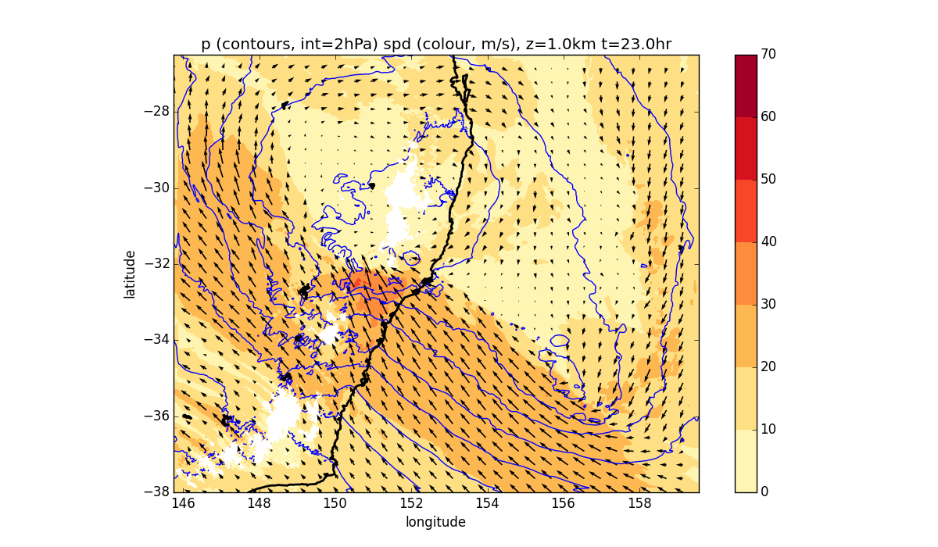
Wind and p at z = 1 km, 23UTC April 21
Wettest member (22)

Slide 51
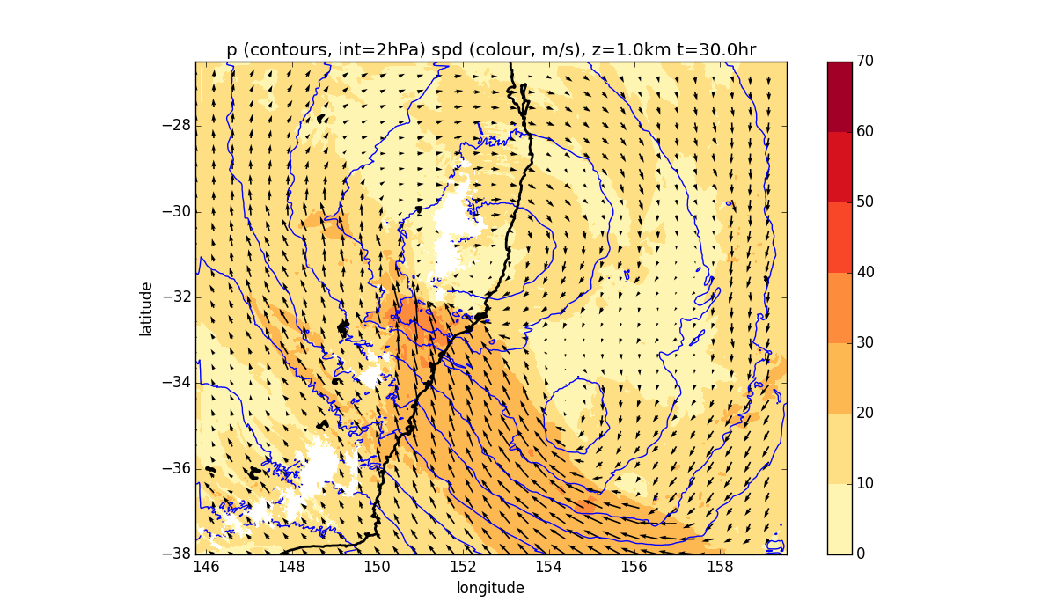
Wind and p at z = 1 km, 06UTC April 22
Wettest member (22)

Slide 52
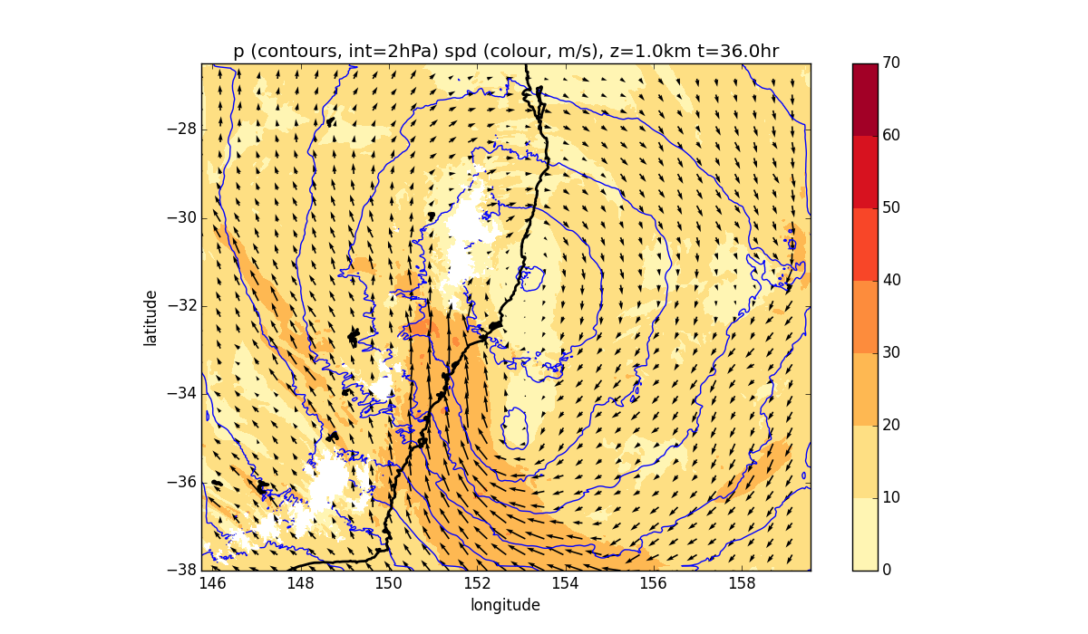
Wind and p at z = 1 km, 12UTC April 22
Wettest member (22)

Slide 53
9 wettest members loop

Slide 54

Formation of meso-low (20 UTC April 21)

Slide 55


10 km + wv imagery 06 UTC April 21
Wettest member (22)

Slide 56


10 km + wv imagery 12 UTC April 21
Wettest member (22)

Slide 57


10 km + wv imagery 18 UTC April 21
Wettest member (22)

Slide 58


10 km + wv imagery 24 UTC April 21
Wettest member (22)

Slide 59


10 km + wv imagery 12 UTC April 22
Wettest member (22)

Slide 60
Summary
High-resolution ensemble of high-impact event
Forecast quality looks excellent
Rainfall and winds sensitive to location of low, very tough forecast with a deterministic system, but …
The ensemble "correctly" identifies area of highest risk

